Slide 1

Charles “Buck” Williams
Summative Portfolio for Induction into the Naismith Memorial Basketball Hall of Fame Class of 2022
Data Analysis Provided by the
Fordham Preparatory School
Sports Analytics Club
Bronx, New York

Slide 2
Player Profile
Full Name | Charles Linwood Williams
Nickname | “Buck”
Position | Power Forward
Shoots | Right
Height | 6’8”
Born | March 8, 1960
College | Maryland
High School | Rocky Mount HS, NC
NBA Debut | October 30, 1981
NBA Career Length | 17 Years

Slide 3
Introduction
In this presentation, we will establish an analytical narrative to support the induction of Buck Williams into the Naismith Memorial Basketball Hall of Fame.
This effort will require an in-depth analysis of Buck Williams’ statistical record. We will provide a novel, innovative exploration into Buck’s overall NBA statistical record.
This analysis clearly illuminates both Buck’s durability, consistency, his game-changing defensive strength, and overall impact on his team.

Slide 4

NBA Records & Accomplishments
3rd Overall pick in the 1981 NBA Draft
3× NBA All-Star (1982, 1983, 1986)
All-NBA Second Team (1983)
2× NBA All-Defensive 1st Team (1990, 1991)
2× NBA All-Defensive 2nd Team (1988, 1992)
NBA Rookie of the Year (1982)
NBA All-Rookie First Team (1982)
No. 52 retired by the Brooklyn Nets
3rd all-time in Offensive Rebounds
16th all-time in Total Rebounds

Slide 5
Supporting Data for Buck Williams’ Induction into the Naismith Memorial Basketball Hall of Fame
In this portfolio, we will provide statistical analyses comparing Buck Williams’ NBA career statistics with several comparable players who have already been inducted into the Naismith Memorial Basketball Hall of Fame. While the focus of this analysis is Mr. Williams’ rebounding and defensive prowess, it is of note that Buck Williams averaged a career double-double in points per game and rebounds (12.8 points per game coupled with 10.0 rebounds per game). Moreover, Buck achieved these numbers over a span of seventeen years. The characteristics that exemplify Mr. Williams’ candidacy are his longevity, durability, consistency, defensive strength, and impact on his team’s ability to win.
We will compare Buck Williams’ field goal percentage, rebounds per game, games played per season, win shares, and defensive win shares to each of the following players:
  Nate Thurmond. Inducted into the Naismith Memorial Basketball Hall of Fame in 1985.
  Bob Lanier. Inducted into the Naismith Memorial Basketball Hall of Fame in 1992.
  Walt Bellamy. Inducted into the Naismith Memorial Basketball Hall of Fame in 1993.
  Ralph Sampson. Inducted into the Naismith Memorial Basketball Hall of Fame in 2012.
  Vlade Divac. Inducted into the Naismith Memorial Basketball Hall of Fame in 2019.
  Jack Sikma. Inducted into the Naismith Memorial Basketball Hall of Fame in 2019.
  Chris Webber. Inducted into the Naismith Memorial Basketball Hall of Fame in 2021.
Our primary source of data was www.nba.com/stats. For the data on win shares and defensive win shares we used www.basketball-reference.com.

Slide 6
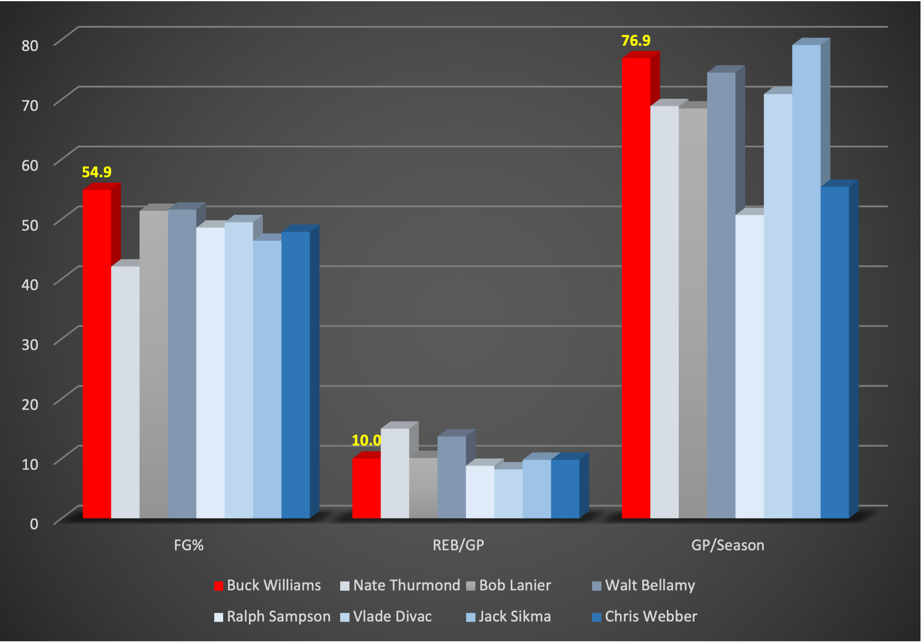

Comparison of Field Goal Percentage, Rebounds Per Game, and Games Played Per Season
Williams performs very well against his comparable players in each of these categories. He is first in field goal percentage, fourth in rebounds per game narrowly behind Lanier, and is second in games played per season.

Slide 7
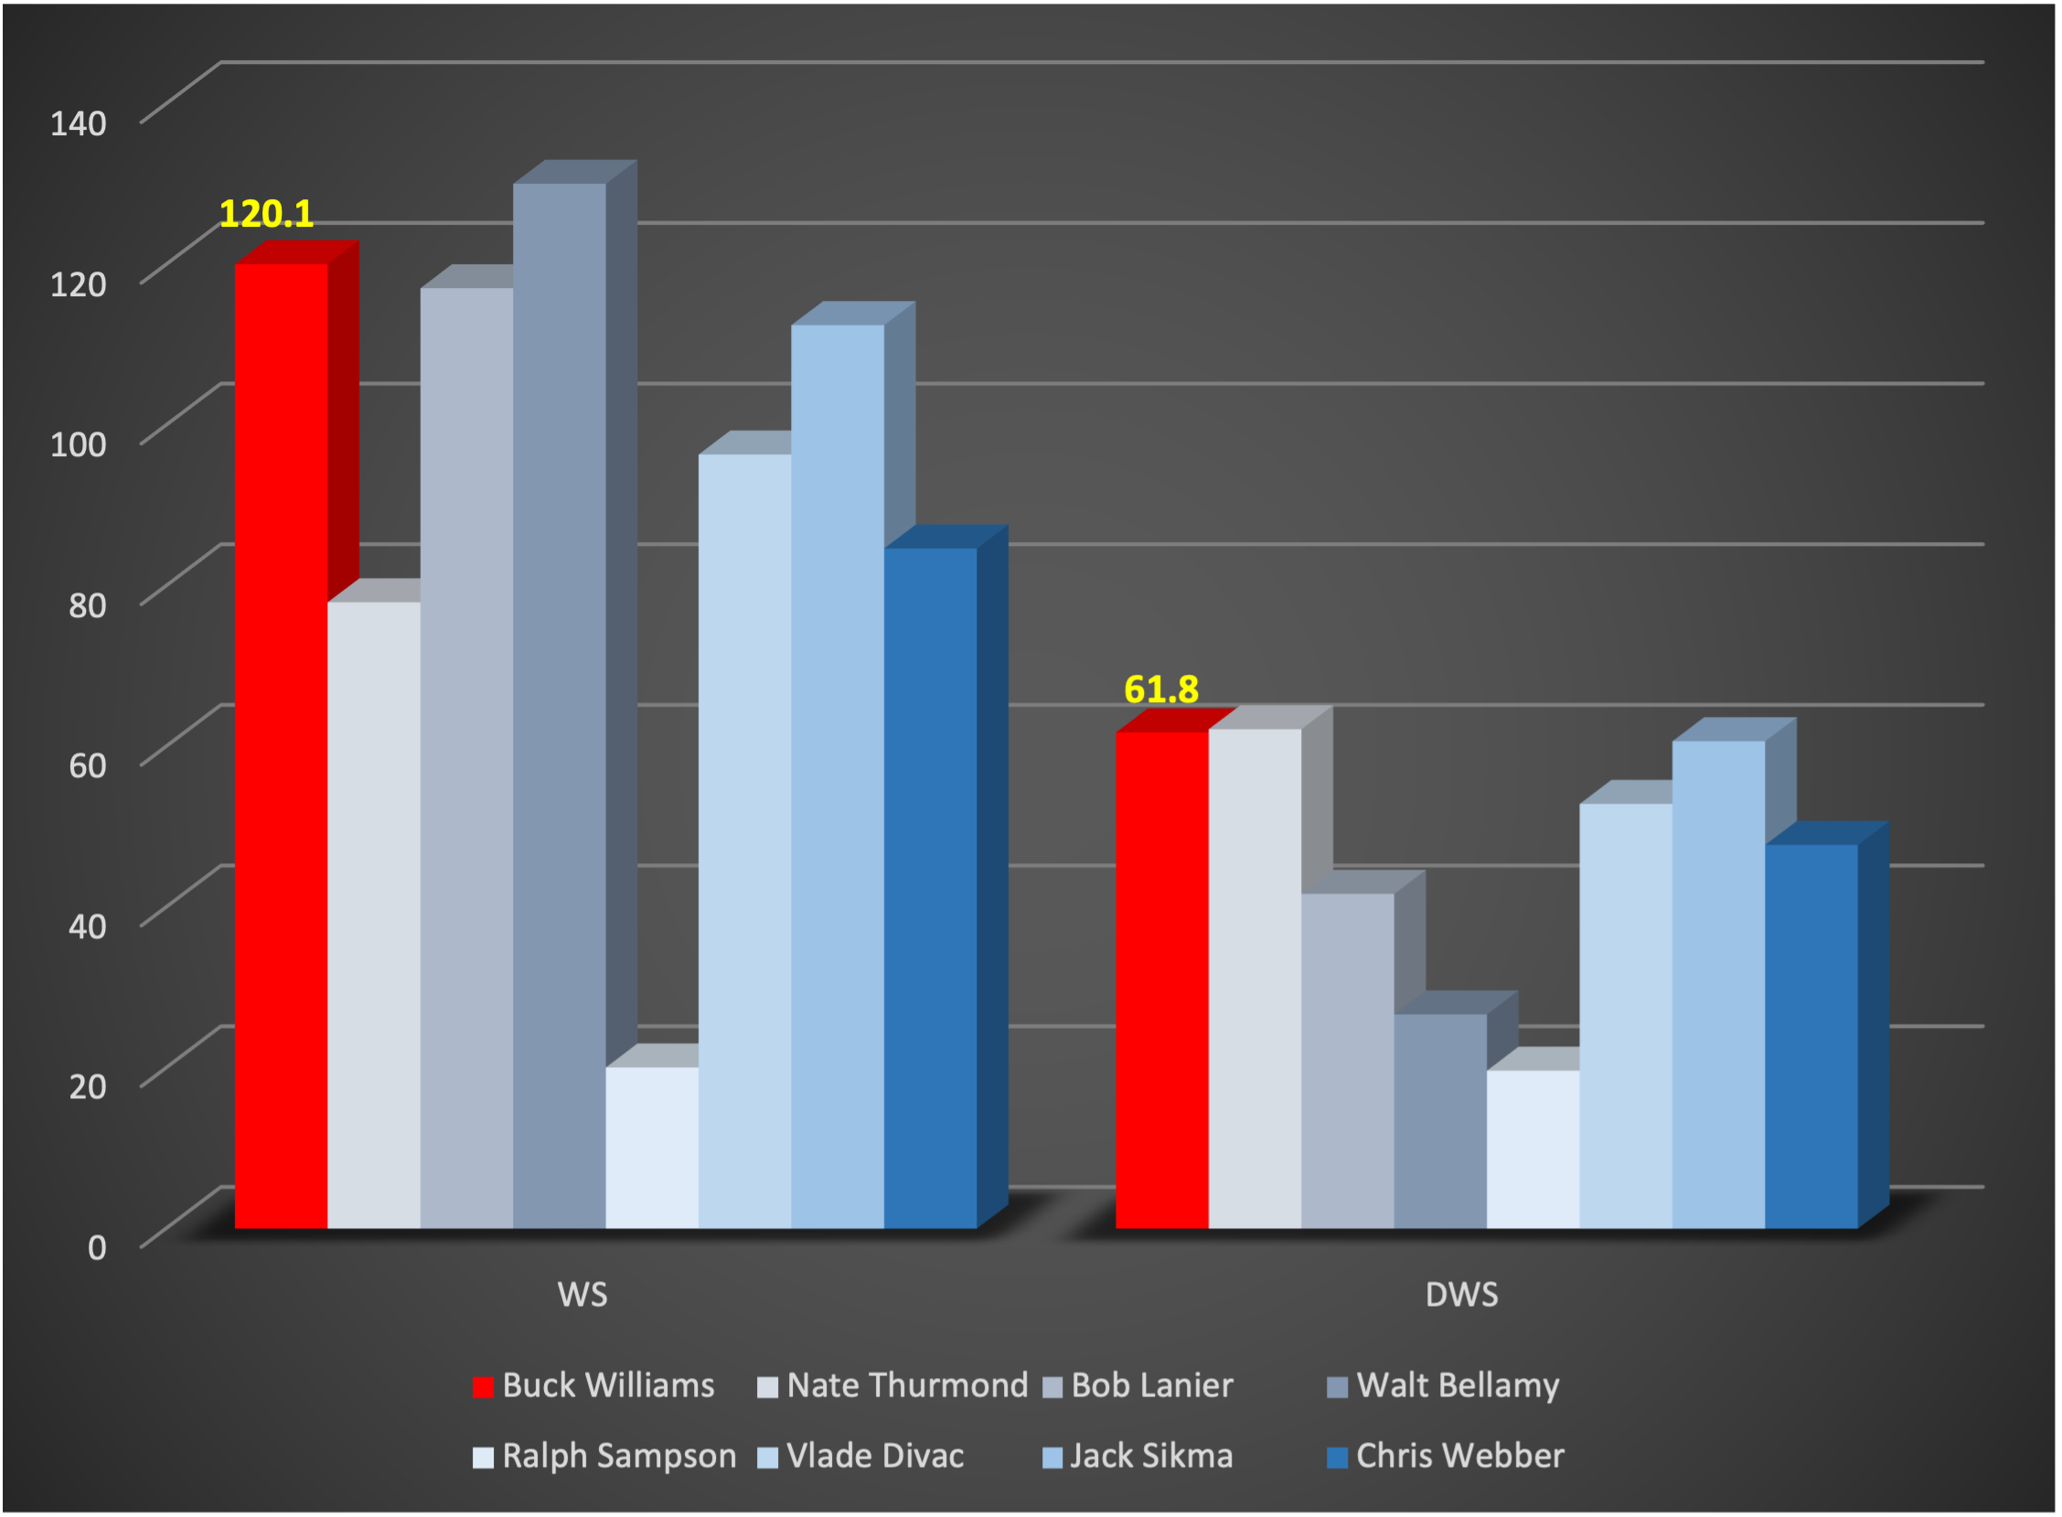
Win Shares and Defensive Win Shares
Win Shares is a player statistic that divides the credit for team success to the individuals of the team. It is calculated using player, team, and league wide stats. The sum of player Win Shares on a given team will be roughly equal to the team's total wins that season.
Giving Defensive Win Shares to a player is based on Dean Oliver’s Defensive Rating¹. Defensive Rating is the estimate of a player's points allowed per 100 defensive possessions.
Buck Williams really stands out in these two categories. He is ranked 50th all-time in Win Shares, second on this list of comparable players only to Walt Bellamy, and he is second on this comparable list in Defensive Win Shares, just behind Nate Thurmond.
¹ Oliver, Dean (2004). Basketball on Paper: Rules and Tools for Performance Analysis.

Slide 8
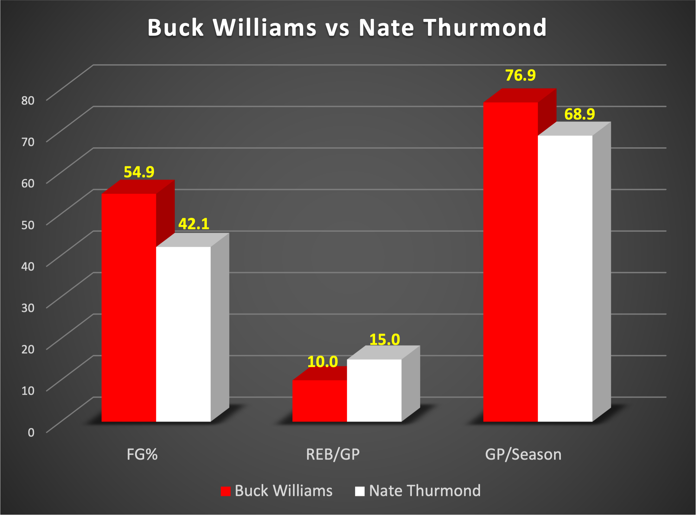
Comparison of Field Goal Percentage, Rebounds Per Game, and Games Played Per Season: Williams vs. Thurmond
Williams exceeds Thurmond in two of the three stats under comparison.
Thurmond, also one of the league’s greatest rebounders of all-time, is ahead of Williams in rebounds per game. However, Buck exceeds Thurmond by 12.8 percentage points in field goal percentage and played in 8 more games per year.

Slide 9
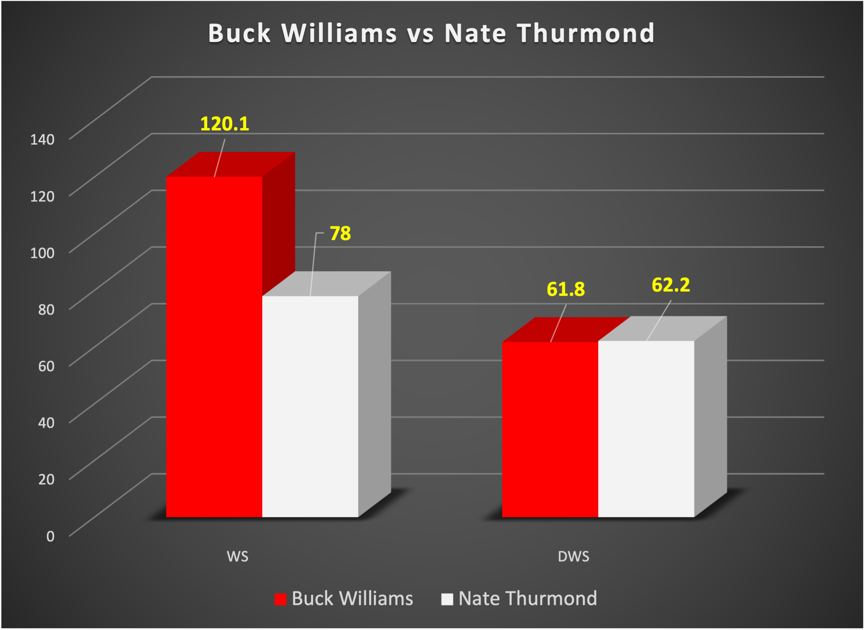
Comparison of Wins Shares and Defensive Win Shares:
Williams vs. Thurmond
Williams has slightly fewer Defensive Win Shares than Thurmond, but Williams has an impressive 53.8% more Win Shares than Thurmond.

Slide 10
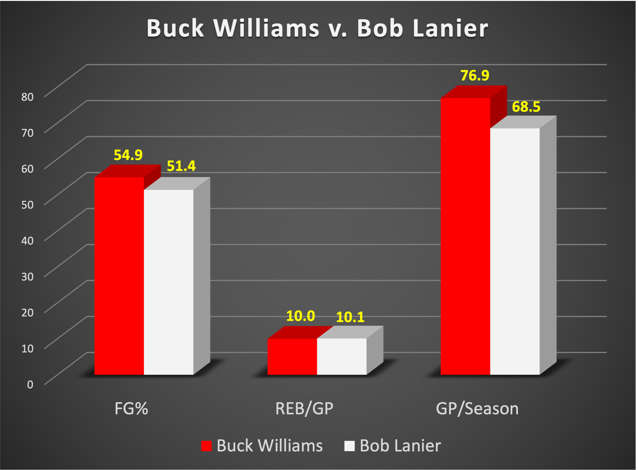
Comparison of Field Goal Percentage, Rebounds Per Game, and Games Played Per Season: Williams vs. Lanier
Williams and Lanier were nearly equal in rebounds per game.
Williams exceeds Lanier in field goal percentage by 3.5 percentage points and Williams played in 8.4 more games each year than Lanier.

Slide 11
Comparison of Wins Shares and Defensive Win Shares:
Williams vs. Lanier
Williams has a slight edge over Lanier in Win Shares and he exceeds Lanier in Defensive Win Shares by an impressive 48%.

Slide 12
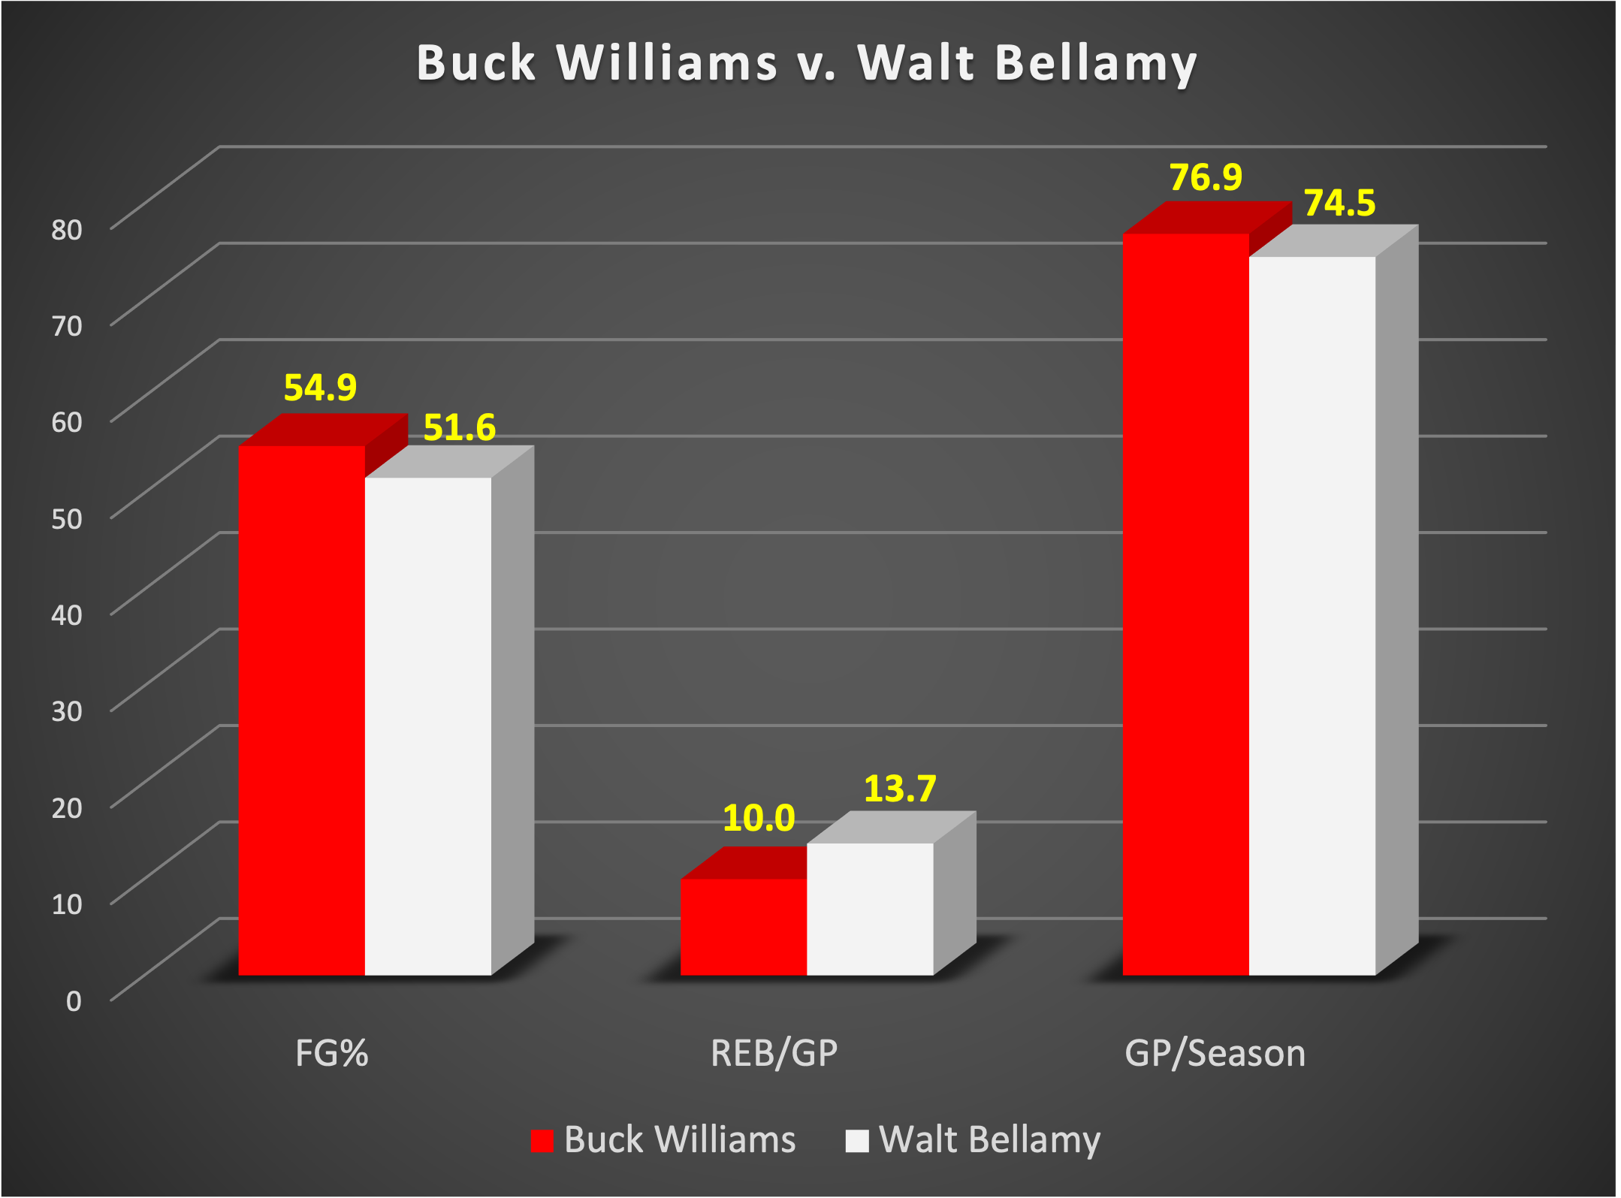
Comparison of Field Goal Percentage, Rebounds Per Game, and Games Played Per Season: Williams vs. Bellamy
Williams exceeds Bellamy in two of the three categories listed, with an edge over Bellamy in field goal percentage and games played per season.

Slide 13
Comparison of Wins Shares and Defensive Win Shares:
Williams vs. Bellamy
Williams exceeds Bellamy in both Win Shares and Defensive Win Shares. He has 25% more Win Shares than Bellamy and more than twice as many Defensive Win Shares.

Slide 14
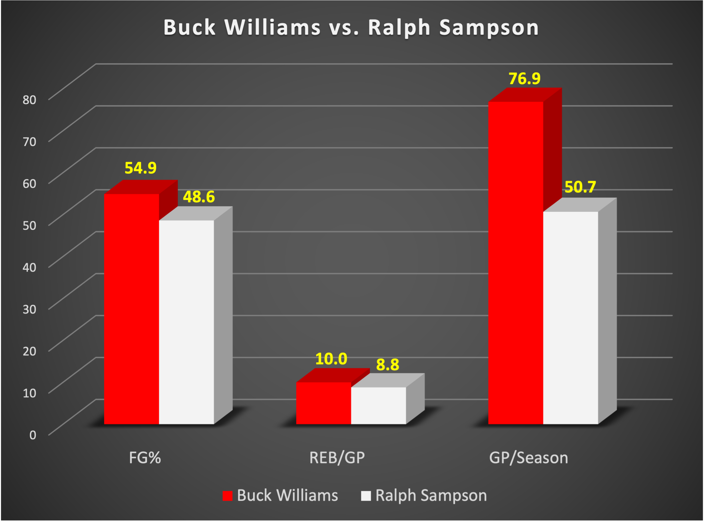
Comparison of Field Goal Percentage, Rebounds Per Game, and Games Played Per Season: Williams vs. Sampson
Williams exceeds Sampson in each of the three stats under comparison.
Williams exceeds Sampson by 6.3 percentage points in field goal percentage, 1.2 percentage points in rebounds per game, and an astounding 51.7% more games played each season.

Slide 15
Comparison of Wins Shares and Defensive Win Shares:
Williams vs. Sampson
Williams dramatically surpasses Sampson in both Win Shares and Defensive Win Shares. Williams has nearly 6 times as many Win Shares as Sampson, and more than 3 times as many Defensive Win Shares as Sampson, again demonstrating Williams’ consistency, durability and impact.

Slide 16
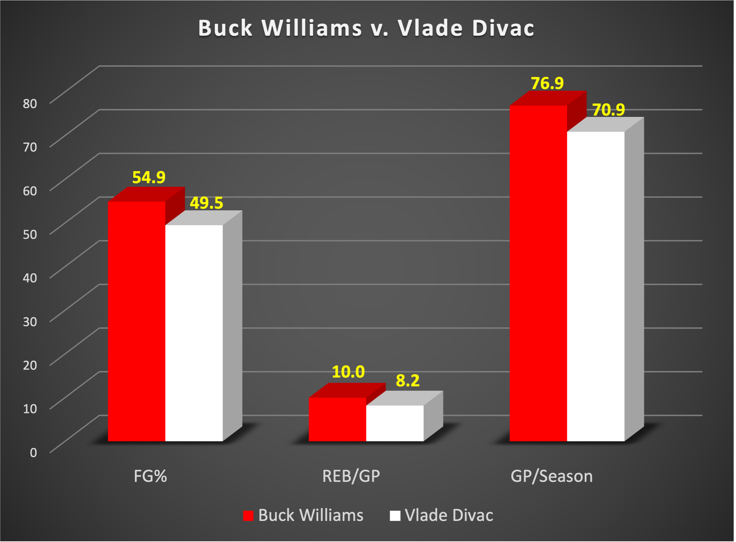
Comparison of Field Goal Percentage, Rebounds Per Game, and Games Played Per Season: Williams vs. Divac
Williams exceeds Divac in each of the three statistics under comparison, by 5 percentage points in field goal percentage, 1.8 percentage points in rebounds per game, and 6 more games played per year.

Slide 17
Comparison of Wins Shares and Defensive Win Shares:
Williams vs. Divac
Williams exceeds Divac in both Win Shares and Defensive Win Shares. He has nearly 25% more Win Shares than Divac and approximately 17% more Defensive Win Shares than Divac.

Slide 18
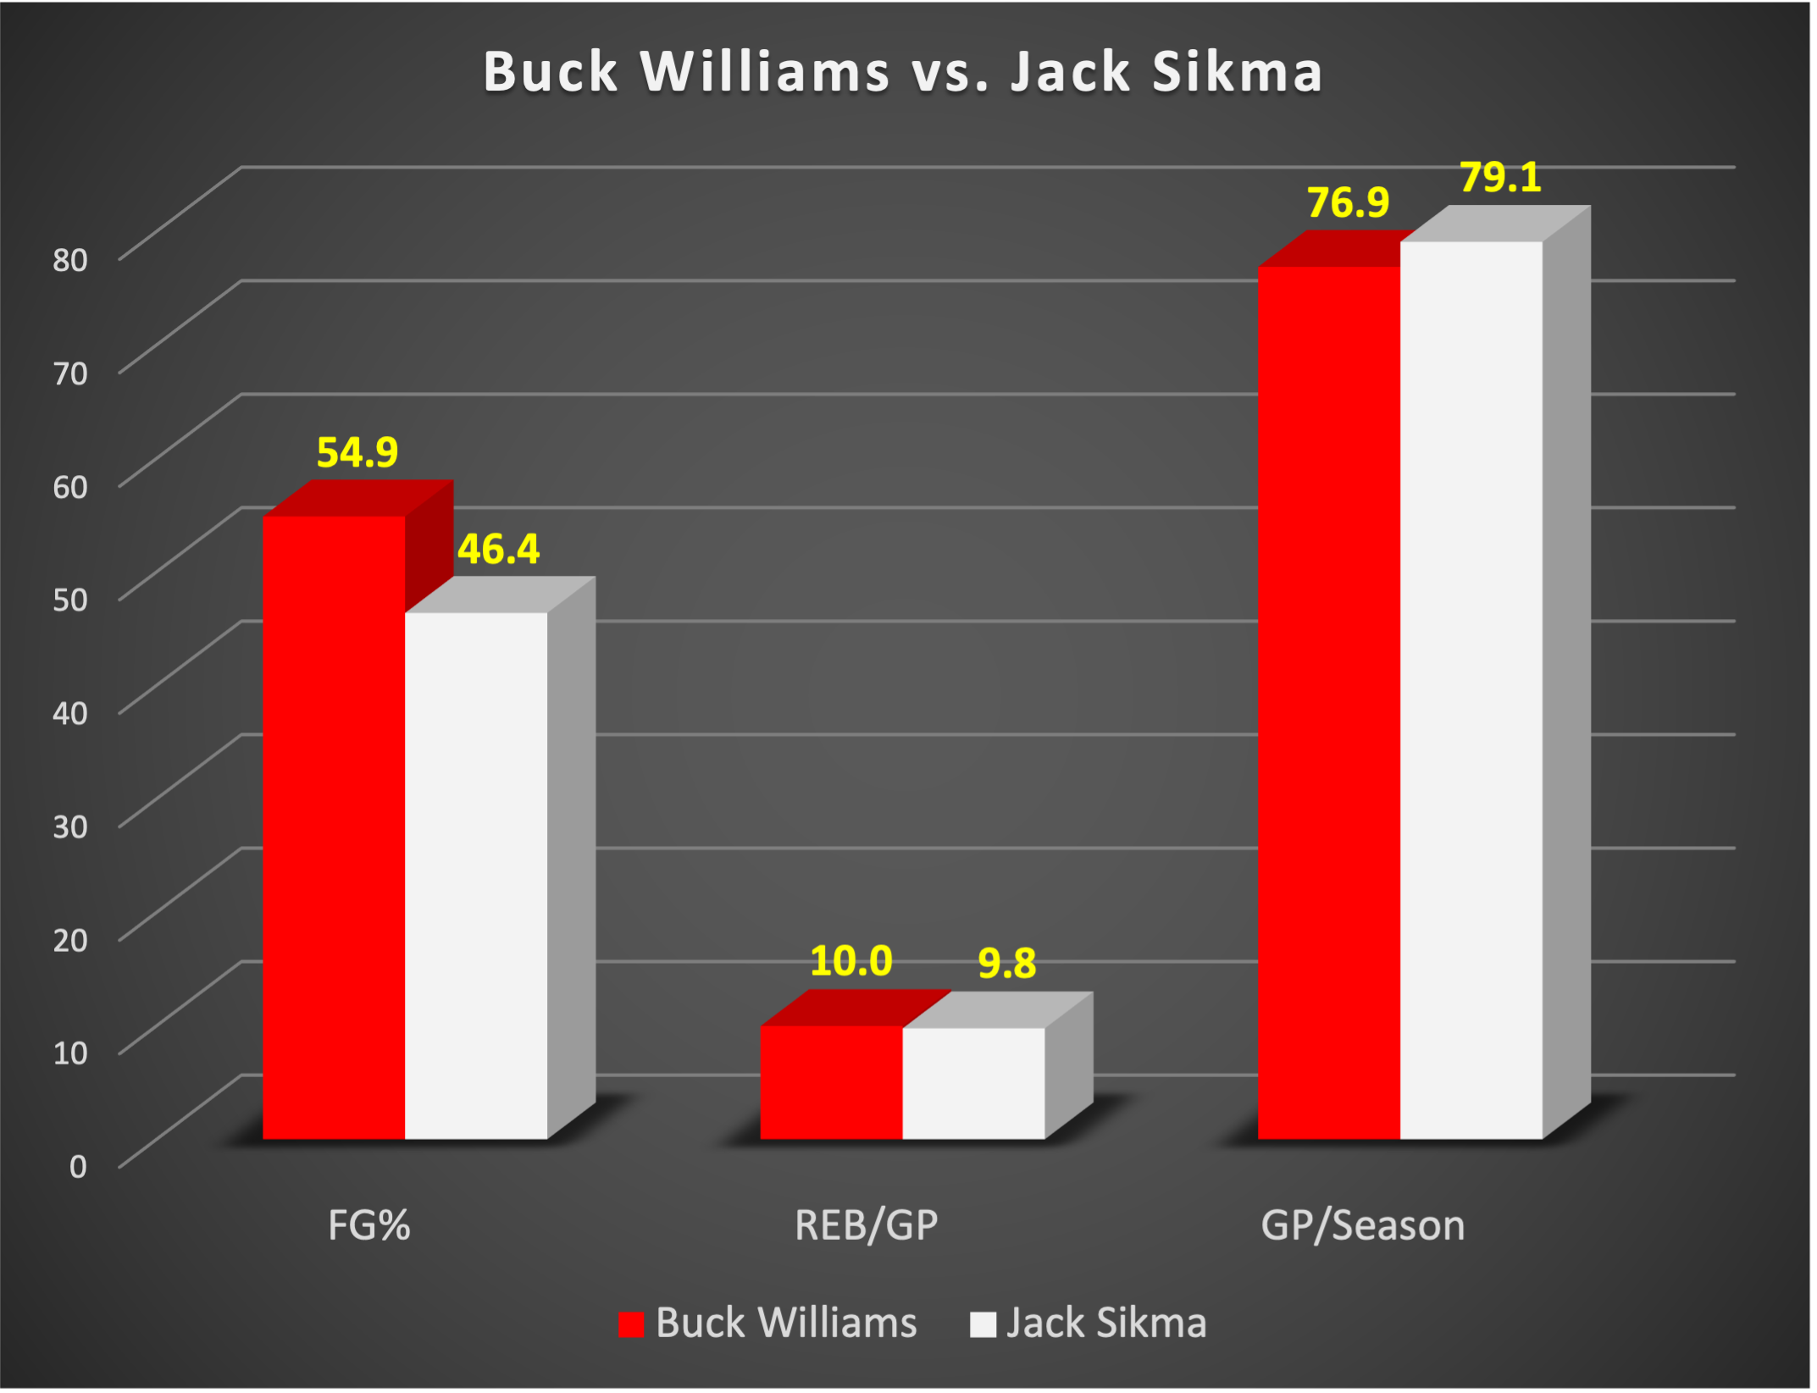
Comparison of Field Goal Percentage, Rebounds Per Game, and Games Played Per Season: Williams vs. Sikma
Williams has a slight edge over Sikma in rebounds per game and Sikma narrowly exceeds Williams in games played per year. However, Buck exceeds Sikma by 8.5 percentage points in field goal percentage.

Slide 19
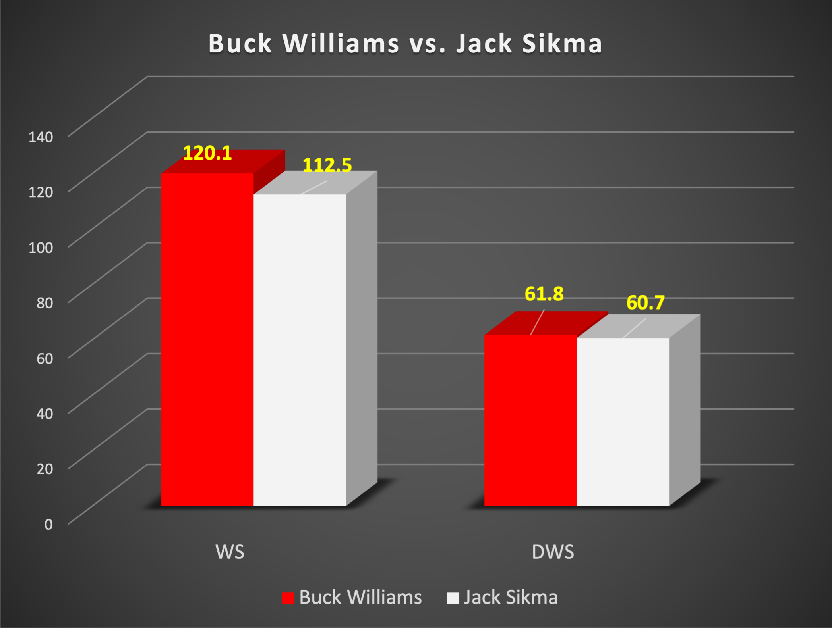
Comparison of Wins Shares and Defensive Win Shares:
Williams vs. Sikma
Buck Williams exceeds Jack Sikma in both Win Shares and Defensive Win Shares. Williams has slightly more Defensive Win Shares than Sikma and has 7.6 more Win Shares than Sikma.

Slide 20
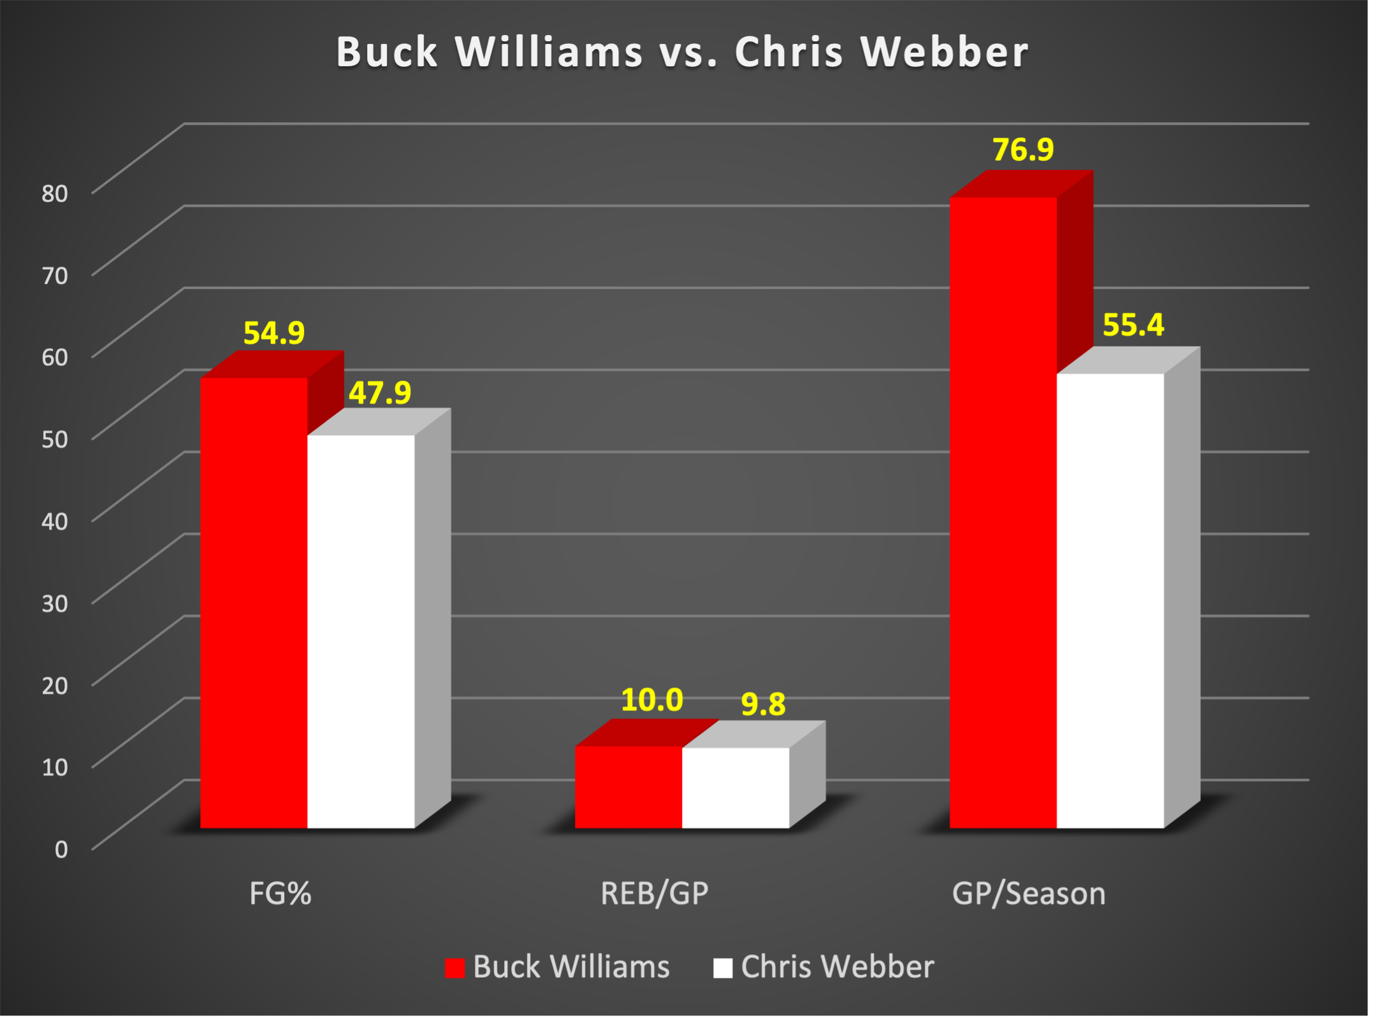
Comparison of Field Goal Percentage, Rebounds Per Game, and Games Played Per Season: Williams vs. Webber
Buck Williams narrowly exceeds Webber in rebounds per game. However, Williams exceeds Webber by 7 percentage points in field goal percentage and played in nearly 39% more games each year than Webber, a testament to Williams’ durability.

Slide 21
Comparison of Wins Shares and Defensive Win Shares:
Williams vs. Webber
Buck Williams has over 40% more Wins Shares than Webber and 29% more Defensive Win Shares than Webber. Both of these measures illustrate Williams’ tremendous impact on his team.

Slide 22
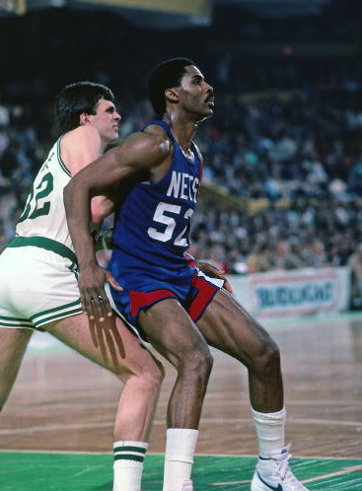
Career Impact
Buck Williams was selected 3rd overall in the 1981 draft by the New Jersey Nets and made an immediate impact. In his rookie season, he averaged 15.5 points and led the team with 12.3 rebounds per game, helping New Jersey win 20 more games than the previous year (with a 44-38 record) and a playoff berth. He also made his first All-Star appearance and won the 1982 Rookie of the Year Award.
Two years later, he led the Nets to the second round of the NBA Playoffs for their first time. In six of his eight years with the Nets, he was ranked among the best three rebounders in the league, and never averaged less than twelve rebounds per game.
In 1989, Williams was traded to the Portland Trail Blazers and was the missing piece that turned them into contenders. Before his arrival, Portland had a 39-43 record and had not made it past the second round of the playoffs since their championship season in 1977. After trading for Williams, the Blazers made it to three straight Western Conference Finals and made two NBA Finals appearances.

Slide 23
Career Impact (continued)
In the 1989-90 season, the Blazers achieved a 59-23 record and reached the NBA Finals, where they lost to the defending champion Detroit Pistons led by Isiah Thomas.
The following season, Williams and the Blazers achieved a 63-19 record and made it to the Western Conference Finals, where they lost to a Los Angeles Lakers team that was led by Magic Johnson.
In the 1991-92 season, the Blazers achieved a 57-25 record and reached the NBA Finals again, this time losing to the defending champion Chicago Bulls led by Michael Jordan.
In seven seasons with the Portland Trail Blazers, Buck Williams finished 5th all-time on the franchise list for career rebounds and field goal percentage.
Buck Williams rounded out his career with two more years with the Knicks from 1996-1998, serving as a reliable backup behind Hall of Famer Patrick Ewing.

Slide 24
Conclusion
Buck Williams was the epitome of longevity, durability, consistency, defensive strength, and impact on his team’s ability to win.
Williams was one of the NBA’s greatest rebounders of all-time. He is 3rd in offensive rebounds and 16th in total rebounds.
Offensively, Williams produced a career double-double in points and rebounds over seventeen, consistent years.
When Williams retired, he was just the 7th NBA player to achieve at least 16,000 points and 13,000 rebounds.
Buck was a great defender and was an impact player. He is ranked 47th all-time in Win Shares.
As we have shown in this portfolio, Buck’s statistical record performs very well against several comparable Hall of Famers.

Slide 25

References
www.nba.com/stats
www.basketball-reference.com
Oliver, Dean (2004). Basketball on Paper: Rules and Tools for Performance Analysis.
www.wikipedia.com
Sports Analytics Club Program - Fordham Preparatory School
Page 25

Slide 26
Acknowledgements
Fordham Preparatory School
Mr. Chad Broussard, Assistant Principal
Dr. Raymond D. González, Sports Analytics Club Moderator
Distinguished Student Contributors: William Bracchitta, Conor Cooper, Shane Daughtry, James Inturrisi, Mateo Jones, Onyinye Okonkwo, Dylan Zwick
St. John’s University
Dr. David Rosenthal, University Advisor to the Fordham Prep Sports Analytics Club
Dr. Joan DeBello
Dr. David Hedlund
National Basketball Association
Kelsey McDonald, NBA Stats Technology Product Development Manager
The Sports Analytics Club Program, Inc.
Robert Clayton, CEO and Co-Founder
Professor Ben Shields, Co-Founder
Ed Tapscott, Board Member and Co-Founder
Christien D. Oliver, National Program Manager
Sports Analytics Club Program - Fordham Preparatory School
Page 26

