Slide 1
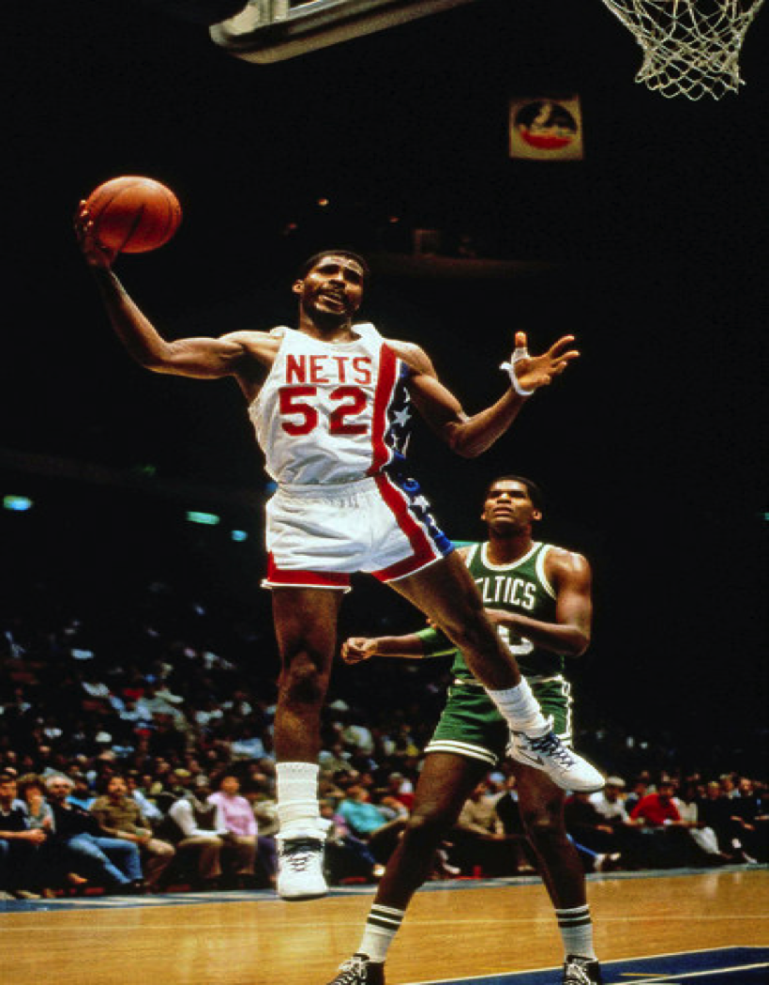
Charles “Buck” Williams
Supplemental Portfolio for Enshrinement into the Naismith Memorial Basketball Hall of Fame Class of 2022
Data Analysis Provided by the
Fordham Preparatory School
Sports Analytics Club
Bronx, New York

Slide 2
Introduction
In this supplemental portfolio, we will elaborate on two analyses that were presented in the original portfolio for the enshrinement of Buck Williams into the Naismith Memorial Basketball Hall of Fame.
This effort will require a closer look at Buck Williams’ all-time statistics on the Total Rebounds and Win Shares lists.
Once again, this focus clearly highlights Buck’s sustained excellence and overall impact on his team.

Slide 3
NBA Top 20 All-Time Total Rebounds List
RANK | PLAYER | REBOUNDS | HOF
1 | Wilt Chamberlin | 23924 | Yes
2 | Bill Russell | 21620 | Yes
3 | Kareem Abdul-Jabbar | 17440 | Yes
4 | Elvin Hayes | 16279 | Yes
5 | Moses Malone | 16212 | Yes
6 | Tim Duncan | 15091 | Yes
7 | Karl Malone | 14968 | Yes
8 | Robert Parish | 14715 | Yes
9 | Kevin Garnett | 14662 | Yes
10 | Dwight Howard | 14627 | Current Player
11 | Nate Thurmond | 14464 | Yes
12 | Walt Bellamy | 14241 | Yes
13 | Wes Unseld | 13769 | Yes
14 | Hakeem Olajuwon | 13748 | Yes
15 | Shaquille O’Neal | 13099 | Yes
16 | Buck Williams | 13017 | No
17 | Jerry Lucas | 12942 | Yes
18 | Bob Pettit | 12849 | Yes
19 | Charles Barkley | 12546 | Yes
20 | Dikembe Mutombo | 12359 | Yes
The table on the left includes the top 20 NBA players in Total Rebounds. Buck Williams is 16th on this exclusive list.
As can be seen, Buck Williams is the only retired player on the NBA’s Top 20 All-Time Total Rebounds List who is not yet in the Naismith Memorial Basketball Hall of Fame.
The only other player on this list who is not yet in the Hall of Fame is Dwight Howard, who is still playing in the NBA.

Slide 4
NBA Top 50 All-Time Win Shares List
RANK | PLAYER | HOF
1 | Kareem Abdul-Jabbar | Yes
2 | LeBron James | Current Player
3 | Wilt Chamberlain | Yes
4 | Karl Malone | Yes
5 | Michael Jordan | Yes
6 | John Stockton | Yes
7 | Tim Duncan | Yes
8 | Dirk Nowitzki | Newly Eligible
9 | Chris Paul | Current Player
10 | Kevin Garnett | Yes
11 | Oscar Robertson | Yes
12 | Shaquille O'Neal | Yes
13 | David Robinson | Yes
14 | Charles Barkley | Yes
15 | Reggie Miller | Yes
16 | Kobe Bryant | Yes
17 | Moses Malone | Yes
18 | Bill Russel | Yes
19 | Hakeem Olajuwon | Yes
20 | Jerry West | Yes
21 | Magic Johnson | Yes
22 | Kevin Durant | Current Player
23 | Paul Pierce | Yes
24 | James Harden | Current Player
25 | Robert Parish | Yes
RANK | PLAYER | HOF
26 | Larry Bird | Yes
27 | Gary Payton | Yes
28 | Ray Allen | Yes
29 | Pau Gasol | Not Yet Eligible
30 | Dolph Schayes | Yes
31 | Dwight Howard | Current Player
32 | Jason Kidd | Yes
33 | Bob Pettit | Yes
34 | Clyde Drexler | Yes
35 | Adrian Dantley | Yes
36 | John Havlicek | Yes
37 | Walt Bellamy | Yes
38 | Steve Nash | Yes
39 | Patrick Ewing | Yes
40 | Vince Carter | Not Yet Eligible
41 | Scottie Pippen | Yes
42 | Shawn Marion | No
43 | Chauncey Billups | No
44 | Elvin Hayes | Yes
45 | Dwayne Wade | Newly Eligible
46 | Stephen Curry | Current Player
47 | Buck Williams | No
48 | Horace Grant | No
49 | Dominique Wilkins | Yes
50 | Chet Walker | Yes
Win Shares is a player statistic that divides the credit for team success to the individuals of the team. It is calculated using player, team, and league wide stats. The sum of player Win Shares on a given team will be roughly equal to the team's total wins that season.
Buck Williams is ranked 47th all-time in Win Shares. Out of the top 50 players on this list, 36 are already in the Naismith Memorial Basketball Hall of Fame and of the remaining 14 players who are not yet in the Hall of Fame, only six of them, including Buck Williams, are eligible. The other 8 are either still playing or are not yet eligible.

Slide 5
Conclusion
Buck Williams was one of the NBA’s greatest rebounders of all-time, ranked 16th in Total Rebounds, and throughout his career had a huge impact on his team’s ability to win, ranking 47th all-time in Win Shares.
He sits on the NBA Top 20 All-Time Total Rebounds List and the NBA Top 50 All-Time Win Shares List surrounded by players already in the Naismith Memorial Basketball Hall of Fame.
We believe that Buck’s sustained excellence over a seventeen year career make a clear case for his enshrinement into the Naismith Memorial Basketball Hall of Fame.

Slide 6
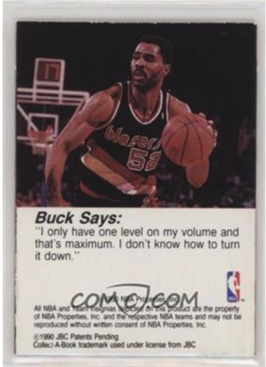
References
www.nba.com/stats
www.basketball-reference.com
Oliver, Dean (2004). Basketball on Paper: Rules and Tools for Performance Analysis.
www.wikipedia.com
Sports Analytics Club Program - Fordham Preparatory School
Page 6

Slide 7
Acknowledgements
Fordham Preparatory School
Mr. Chad Broussard, Assistant Principal
Dr. Raymond D. González, ISTEAM Coordinator - Sports Analytics Club Moderator
Distinguished Student Contributors: William Bracchitta, Conor Cooper, Shane Daughtry, Nicholas DiFabio, James Inturrisi, Mateo Jones, Landon Lynch, Onyinye Okonkwo, Dylan Zwick
St. John’s University
Dr. David Rosenthal, University Advisor to the Fordham Prep Sports Analytics Club
Dr. Joan DeBello
Dr. David Hedlund
National Basketball Association
Kelsey McDonald, NBA Stats Technology Product Development Manager
The Sports Analytics Club Program, Inc.
Robert Clayton, CEO and Co-Founder
Ben Shields, Co-Founder
Ed Tapscott, Board Member and Co-Founder
Christien D. Oliver, National Program Manager
Sports Analytics Club Program - Fordham Preparatory School
Page 7

